Slide 1
The Language of Maths in science
Mr S Mcintosh

Slide 2
The FIFA method.
The FIFA acronym stands for:
FORMULA - Lookup/recall/infer
INSERT VALUES - Decode from the question
FINE TUNE - Simplify maths
ANSWER - Calculate and answer

Slide 3
Fine tuning
There are two rules to rearranging equations.
You can do anything to one side of an equation AS LONG as you do it to the other side.
Anything divided by itself is 1.

Slide 4
Fine tuning
E.G. 5a+2=17
The problem can be solved if you think about the problem in terms of a balance.

Slide 5
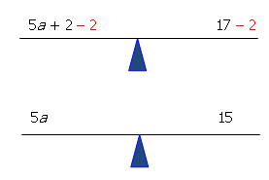
Fine tuning

Slide 6
Fine tuning
Since 5 is multiplied by a, you can get a by itself (or isolate it) by dividing by 5. Remember that whatever you do to one side, you have to do to the other.

Slide 7
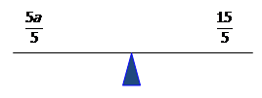
Fine tuning
Therefore a=3.

Slide 8
The FIFA method.
Example 1 – Beyond the form a=bc.

Slide 9
Students have to recall the relevant equation as it is not given on the Data and Formula Sheet. They write it down. This is an important step as once it is written down they no longer have to hold it in their working memory.

Slide 10
Note that this is less cognitively demanding on the student’s working memory as they only have to recall the formula on its own; they do not have to recall the formula triangle associated with it.
Students find it encouraging that on many mark schemes, the selection of the correct equation may gain a mark, even if no further steps are taken.

Slide 11
Note that since we are considering each item of data individually and in a sequence determined by the written formula, this is much less cognitively demanding in terms of what needs to be held in the student’s working memory than the formula triangle method.

Slide 12
Note also that on many mark schemes, a mark is available for the correct substitution of values. Even if they were not able to proceed any further, they would still gain 2/5 marks. For many students, the notion of incremental gain in calculation questions needs to be pushed really hard otherwise they will not attempt these “scary” calculation questions.

Slide 13
Next we are going to “fine tune” what we have written down in order to calculate the final answer. In this instance, the “fine tuning” process equates to a simple algebraic rearrangement. However, it is useful to leave room for some “creative ambiguity” here as we can also use the “fine tuning” process to resolve difficulties with units. Tempting though it may seem, DON’T change FIFA to FIRA.

Slide 14
The FIFA method.
Example 2 – Managing powers.

Slide 15
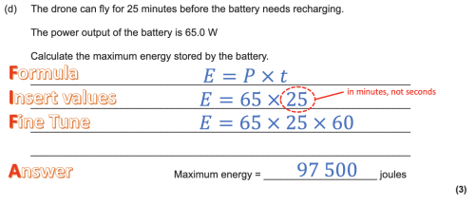

Slide 16
The FIFA method.
Example 3 – Further scaffolding for foundation.
For the majority of low demand questions, the required formula will be supplied so students will not need to recall it.
What they will need, however, is support in inserting the values correctly. Providing a framework can be very helpful.

Slide 18
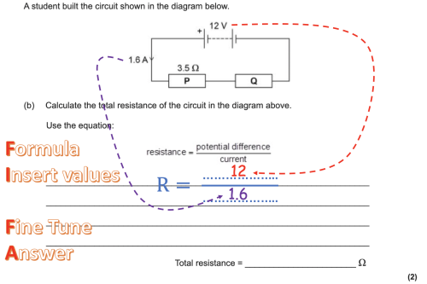
Clearly indicating where the data came from is useful.

Slide 19
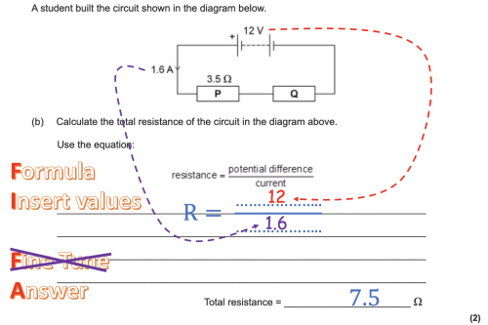

Slide 20
Limits on measurements
School stopwatches often measure to a hundredth of a second giving values like 23.34 seconds… however it is not physically possible to measure that accurately.
A good human reaction time could be 0.2 seconds meaning that this value is…
23.34 ± 0.2 seconds
… thus making the 4 irrelevant.
23.3 ± 0.2 seconds

Slide 21
Significant figures and calculations
A feather falls 2.2 meters In 1.3 seconds.
Many of these decimal places are pointless due to the limits on measuring equipment, however, more damagingly that answer suggests an accuracy of measurement that does not exist.
A useful rule of thumb is to round the result to the same number of significant figures as the measured value with the fewest significant figures. This means that the precision of the result is determined by the least precise value used in the calculation.
$$Speed= \frac{Distance}{Time}= \frac{2.2}{1.3}=1.69230769231 m/s$$
$$\text{≈} 1.7 m/s$$

Slide 22
Standard form and communication
Science is a language, much is communicated verbally. Numbers are not easy to communicate verbally so in science it makes sense to speak in pre-fixes.
e.g. laser physics deals a lot with viable light. Visible light is between 400-700nm so we tend to communicate in nano meters.
Red light is 680 nm.

Slide 23
Pre-Fix form
Red light = 680 x10⁻⁹ NOT 6.8 x10⁻⁷ as no prefix exists for x10⁻⁷.
When we speak this number in science we say six hundred and eighty nano meters.
When we write the number however is it not in standard form.
680 x10⁻⁹ is pre-fix form as it uses the language of the pre-fix not standard form.

Slide 24
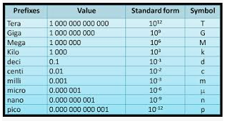
Pre-fix form and communication

Slide 25
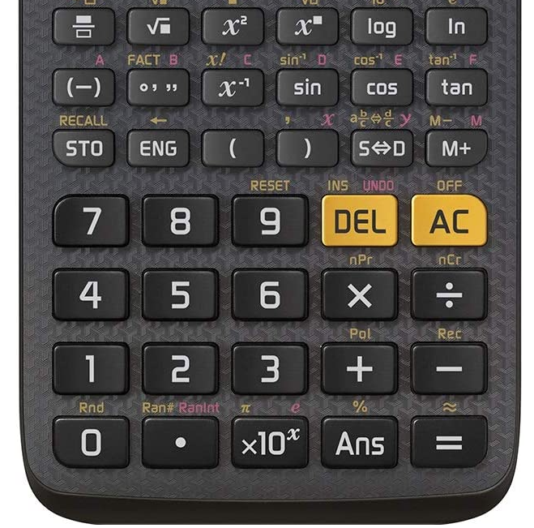

Slide 26
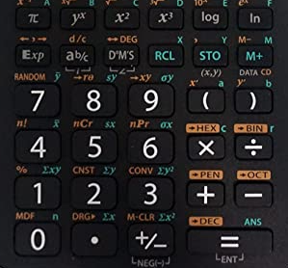

Slide 27
References.
All question examples plagiarised from https://emc2andallthat.wordpress.com/2019/10/27/fifa-for-the-gcse-physics-calculation-win/

