Slide 1
The Language of Maths in science
Mr S Mcintosh

Slide 2
Quantitative vs Qualitative.
As an example, take the data that could be collected about the pupils in a class. Measuring the heights of the pupils would produce quantitative data, while their eye colours would be qualitative data.
Quantitative data relate to a quantity. In this case ‘Height of pupil’ and, for each pupil there is a value for this quantity. The values are not just numbers.
If the height of a pupil is 119cm then the value consits of a number (119) and a unit (cm). So, any calculation done on the value (119cm) must be done on the number AND the unit.

Slide 3
Quantitative vs Qualitative.
As an example, take the data that could be collected about the pupils in a class. Measuring the heights of the pupils would produce quantitative data, while their eye colours would be qualitative data.
By contrast, the eye colours of pupils represent qualitative data – there are no numbers involved.
If the numbers of pupils with each eye colour are counted, then each eye colour becomes a category with an associated numerical value. Thus, quantitative data can be generated from qualitative data.

Slide 4
Quantitative vs Qualitative.
Another instance of qualitative vs quantitative that is important in science teaching relates to the level of understanding required by pupils of different abilities.
To achieve at the highest levels in a GCSE a pupil may need to have a solid understanding of the quantitative relationship between Force and Acceleration requiring them to use the equation F=ma.
A pupil working at a lower level may only need a qualitative understanding of “Doubling the force doubles the acceleration”

Slide 5
Discontinuous vs continuous.
Discrete data can only take particular values. Discrete data can be numeric, like numbers of apples, but it can also be categorical such as eye colour.
Continuous data are not restricted to defined separate values, but can occupy any value over a continuous range.

Slide 6
Discontinuous vs continuous.

Slide 8
Measurement, resolution and significant figures
The values of measurements are limited by the resolution of the measuring instrument whether analogue (e.g. a ruler) or digital (e.g. an electronic balance). It is easy to do a calculation to get a number such as 2.3913043 displayed on a calculator; it is not possible, however, to use a school stopclock to record a value for a time such as 2.3913043 seconds. To do this would require an instrument with higher resolution.
Values in science inherently have an implied resolution or accuracy even after calculations have been done. This is related to the accuracy of measuring equipment and an estimation of error.

Slide 9
Limits on measurements
School stopwatches often measure to a hundredth of a second giving values like 23.34 seconds… however it is not physically possible to measure that accurately.
A good human reaction time could be 0.2 seconds meaning that this value is…
23.34 ± 0.2 seconds
… thus making the 4 irrelevant.
23.3 ± 0.2 seconds

Slide 10
Significant figures and calculations
A feather falls 2.2 meters In 1.3 seconds.
Many of these decimal places are pointless due to the limits on measuring equipment, however, more damagingly that answer suggests an accuracy of measurement that does not exist.
A useful rule of thumb is to round the result to the same number of significant figures as the measured value with the fewest significant figures. This means that the precision of the result is determined by the least precise value used in the calculation.
$$Speed= \frac{Distance}{Time}= \frac{2.2}{1.3}=1.69230769231 m/s$$
$$\text{≈} 1.7 m/s$$

Slide 11
Standard form and communication
Science is a language, much is communicated verbally. Numbers are not easy to communicate verbally so in science it makes sense to speak in pre-fixes.
e.g. laser physics deals a lot with viable light. Visible light is between 400-700nm so we tend to communicate in nano meters. This effects the maths in this discipline where wavelengths are written in nano meters not obeying the standard form rules of maths.
Red light = 680 x10⁻⁹ NOT 6.8 x10⁻⁷ as no prefix exists for x10⁻⁷.

Slide 12
Pre-Fix form
Red light = 680 x10⁻⁹ NOT 6.8 x10⁻⁷ as no prefix exists for x10⁻⁷.
When we speak this number in science we say six hundred and eighty nano meters.
When we write the number however is it not in standard form.
680 x10⁻⁹ is pre-fix form as it uses the language of the pre-fix not standard form.

Slide 13
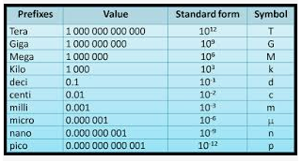
Pre-fix form and communication

Slide 14
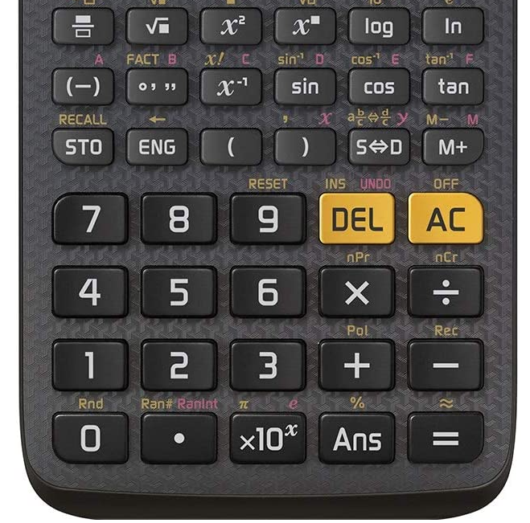

Slide 15
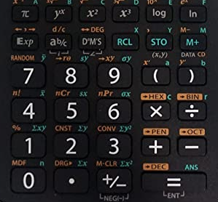

Slide 16
Equation work: Why we shouldn’t use formula triangles.
Formula triangles are bad news. They are a cognitive dead end.
They are a trick that hides the maths: students don’t apply the skills they have previously learned. This means students don’t realise how important maths is for science.
I’m also concerned that if students can’t rearrange simple equations like the one above, they really can’t manage when equations become more complex.
— Jenny Koenig, https://edu.rsc.org/ideas/why-are-formula-triangles-bad/2010169.article

Slide 17
The formula triangle and other problems with procedural teaching in mathematics - Ed Southall
The formula triangle is a visual prompt that allows for the rearranging of a simple formula that must be in the form a=bc which bypasses any prerequisite knowledge of algebra.
Fortunately, there are a number of formulae that students use at school that come in the form a=bc, such as:
distance = speed × time
force = mass × acceleration
mass = density × volume
We will delve into this a little shortly.
http://eprints.hud.ac.uk/id/eprint/29803/1/SSR%20March%202016%20049-053%20Southall.pdf

Slide 18
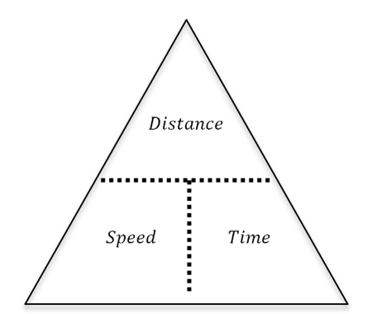
By placing a finger over the part of the triangle that you wish to be the subject, the remaining letters on show are easy to identify in the correct format as if it had been rearranged. This approach is a classic procedural method. There is no mathematical reasoning behind what is being described, and the expectation is that students will simply mimic the steps and reach an answer.
http://eprints.hud.ac.uk/id/eprint/29803/1/SSR%20March%202016%20049-053%20Southall.pdf

Slide 19
… important elements of problem solving may be negated in exchange for a quick win. It is unsatisfying and inflexible. There is the very real possibility that students may begin to erroneously apply the idea of a formula triangle to other equations. Consider y=mx+c. Rearranging for c is easier than rearranging speed = distance / time , but only if you have an understanding of what you are doing. Use a formula triangle and students will simply get the wrong answer. Worse still, a student could very realistically have no idea that it is even wrong.
http://eprints.hud.ac.uk/id/eprint/29803/1/SSR%20March%202016%20049-053%20Southall.pdf

Slide 20
“How many formula are in the form a=bc in the physics GCSE?”

Slide 21
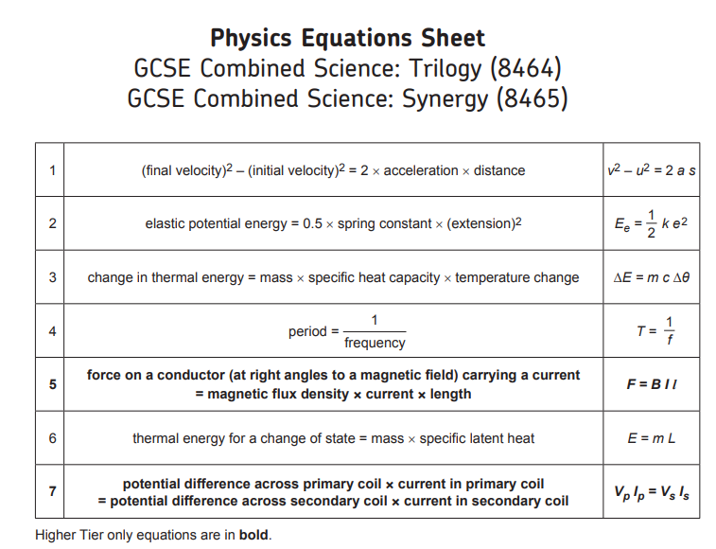
“a=bc” count = 2

Slide 22
“You are being a little disingenuous here… there are LOADS more equations on the physics GCSE!”

Slide 23
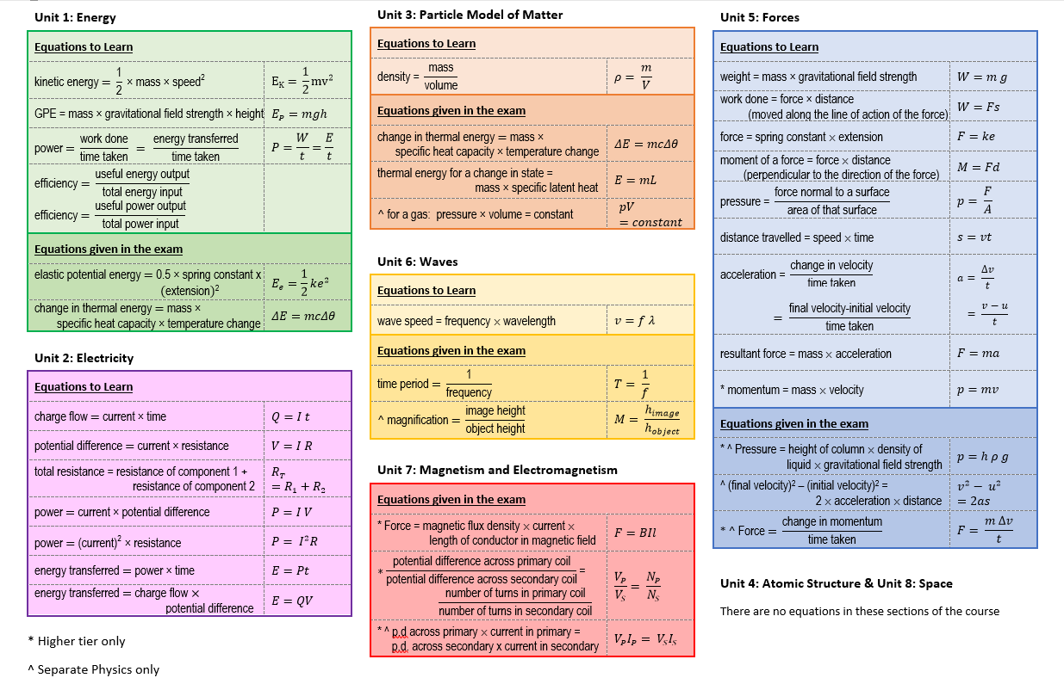
Trilogy H-Tier:
Equations 29.
“a=bc count = 19”
% = 66%
Physics H-Tier:
Equations 34.
“a=bc count = 21”
% = 62%

Slide 24
“Wait, Some of those equations CAN be put in a triangle.. Look!”

Slide 25
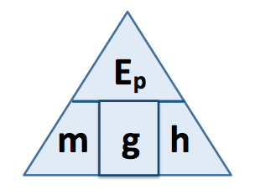
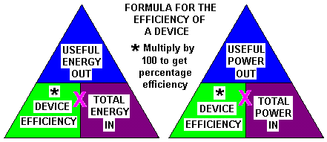
These require you to remember specific information related to this situation going against the entire point of the triangle. More than 3 terms, how to deal with the squared and when to multiply by 100 to get a %.

Slide 26
Cognitive load.
The use of formula triangle also increases (rather than decreases) the cognitive load on students when carrying out calculations.
For example, if the distance travelled by a car is 50 meters and the time taken for this is 10 seconds, to work out the speed of the car the pupil must.
recall the relevant equation and what each symbol means and hold it in working memory
recall the layout of symbols within the formula triangle and either (a) write it down or (b) hold it in working memory
recall that d and t are known values and that s is the unknown value and hold this information in working memory when applying the formula triangle to the problem

Slide 27
Cognitive load.
Triangles ‘work’ for only 2/3 of the equations on trilogy science
Negates problem solving skills in favour of a quick win.
Pupils can not establish at any point if their equation is correct or not.
Often applied incorrectly to equations that contain more than 3 terms or have a power.
Increases cognitive load on the pupil anyway.

Slide 28
The FIFA method.
The FIFA acronym stands for:
FORMULA - Lookup/recall/infer
INSERT VALUES - Decode from the question
FINE TUNE - Simplify maths
ANSWER - Rearrange and answer

Slide 29
Fine tuning
There are two rules to rearranging equations.
You can do anything to one side of an equation AS LONG as you do it to the other side.
Anything divided by itself is 1.

Slide 30
Fine tuning
E.G. 5a+2=17
The problem can be solved if you think about the problem in terms of a balance.

Slide 31
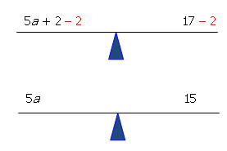
Fine tuning

Slide 32
Fine tuning
Since 5 is multiplied by a, you can get a by itself (or isolate it) by dividing by 5. Remember that whatever you do to one side, you have to do to the other.

Slide 33
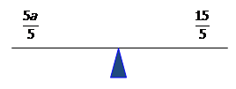
Fine tuning
Therefore a=3.

Slide 34
The FIFA method.
Example 1 – Beyond the form a=bc.

Slide 35
Students have to recall the relevant equation as it is not given on the Data and Formula Sheet. They write it down. This is an important step as once it is written down they no longer have to hold it in their working memory.

Slide 36
Note that this is less cognitively demanding on the student’s working memory as they only have to recall the formula on its own; they do not have to recall the formula triangle associated with it.
Students find it encouraging that on many mark schemes, the selection of the correct equation may gain a mark, even if no further steps are taken.

Slide 37
Note that since we are considering each item of data individually and in a sequence determined by the written formula, this is much less cognitively demanding in terms of what needs to be held in the student’s working memory than the formula triangle method.

Slide 38
Note also that on many mark schemes, a mark is available for the correct substitution of values. Even if they were not able to proceed any further, they would still gain 2/5 marks. For many students, the notion of incremental gain in calculation questions needs to be pushed really hard otherwise they will not attempt these “scary” calculation questions.

Slide 39
Next we are going to “fine tune” what we have written down in order to calculate the final answer. In this instance, the “fine tuning” process equates to a simple algebraic rearrangement. However, it is useful to leave room for some “creative ambiguity” here as we can also use the “fine tuning” process to resolve difficulties with units. Tempting though it may seem, DON’T change FIFA to FIRA.

Slide 40
The FIFA method.
Example 2 – Managing powers.

Slide 41
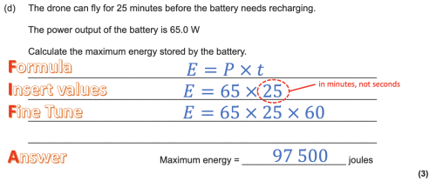

Slide 42
The FIFA method.
Example 3 – Further scaffolding for foundation pupils.
For the majority of low demand questions, the required formula will be supplied so students will not need to recall it.
What they will need, however, is support in inserting the values correctly. Providing a framework can be very helpful.

Slide 44
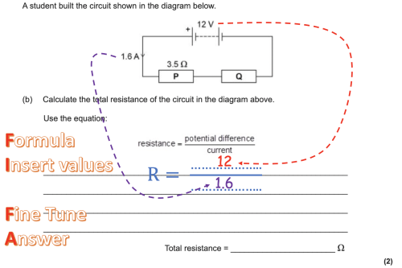
Clearly indicating where the data came from is useful.

Slide 45
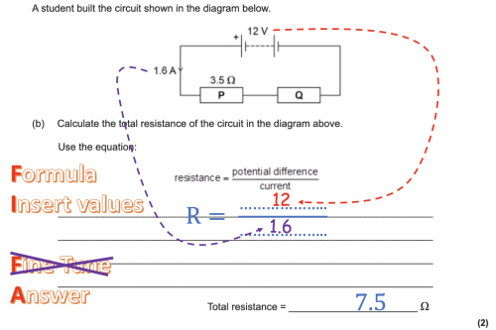

Slide 46
References.
All question examples plagiarised from https://emc2andallthat.wordpress.com/2019/10/27/fifa-for-the-gcse-physics-calculation-win/

